Slide 1
The Workplace (Health, Safety and Welfare) Regulations 1992.
Please study each slide with its accompanying notes to get to know the subject
Dr. Bob Rajan OBE JP PhD
Notes:
This presentation summarises the requirements of the Workplace (Health, Safety and Welfare) Regulations 1992.

Slide 2
Welfare at work
An employer must:
1. Provide adequate and appropriate welfare facilities for his employees while they are at work.
2. Consider and provide for the needs of employees with disabilities
Notes:
Do not forget the Disability Discrimination Act has influence too.

Slide 3
Welfare at work
Will Include:
Drinking water
Toilets
Washing facilities
Some where to sit, eat and make hot drinks
Somewhere to change cloths, if required to do the work safely
Notes:
What facilities needs to be provide for changing and storing clothing?
If the work activity requires employees to change into and wear specialist clothing (overalls, a uniform, thermal clothing etc), then employer must provide enough changing rooms for the number of people expected to use them.
Where a changing room is provided it should:
■ be readily accessible;
■ contain, or lead directly to, clothing storage and washing facilities; ■ provide seating;
■ provide a means for hanging clothes _ a hook or peg may be sufficient;
■ ensure the privacy of the user. Separate use of changing facilities should be available to men and women.

Slide 4
Welfare at work
What is meant by adequate toilet and washing facility
Enough number of toilets
Large enough and enough number of washbasins
Separate facilities for men and women (or lockable)
Clean, well ventilated and “lit”
Supply of toilet paper
Sanitary pads disposer
Running hot and cold water
Lathering agent
Hand “dryer”
Notes:
If you want know more, see HSE guidance(see slide 1) for more details on each of the issue, but that is for the employer to deliver.
If the facility you are using have the key features described on this slide, you are likely to have an acceptable facility.

Slide 5
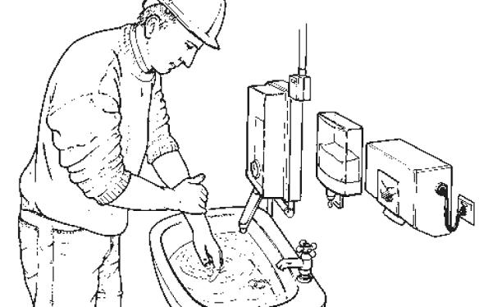
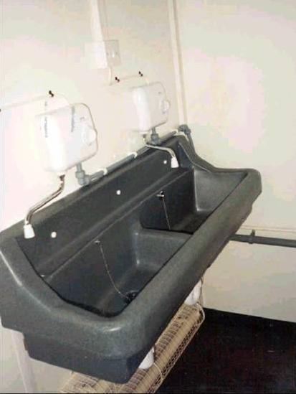
Is this an appropriate welfare facility?
Notes:
The wash basins have hot/cold running water, lathering and drying facility is seen. Clean. Overall both facilities are likely to be acceptable.

Slide 6
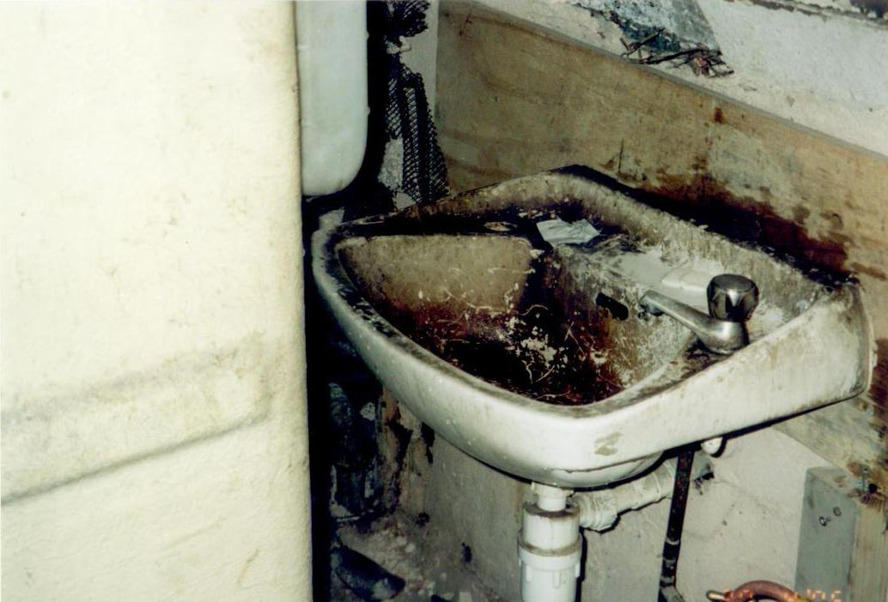
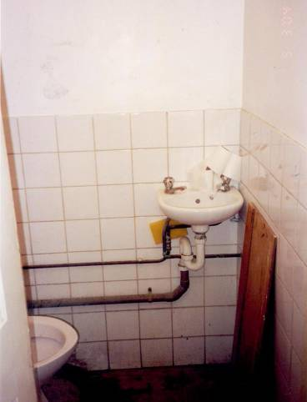
Is this an adequate and appropriate welfare facility?
Notes:
Pictures paint the scene – No
The corner unit is too small to facilitate washing hands and forearms. Toilet walls and floor appear to be dirty. Require a closer observation.
Do you think that the occupier of this facility care about their workers.
Do you think a HSE inspector inspecting this facility would take action.
Discuss/examine both questions.

Slide 7
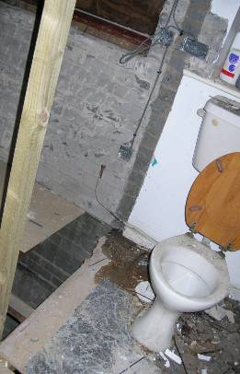
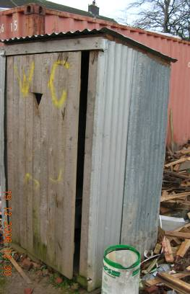
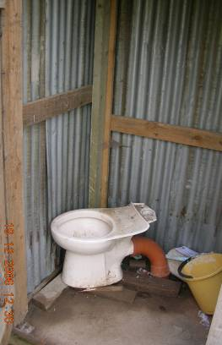
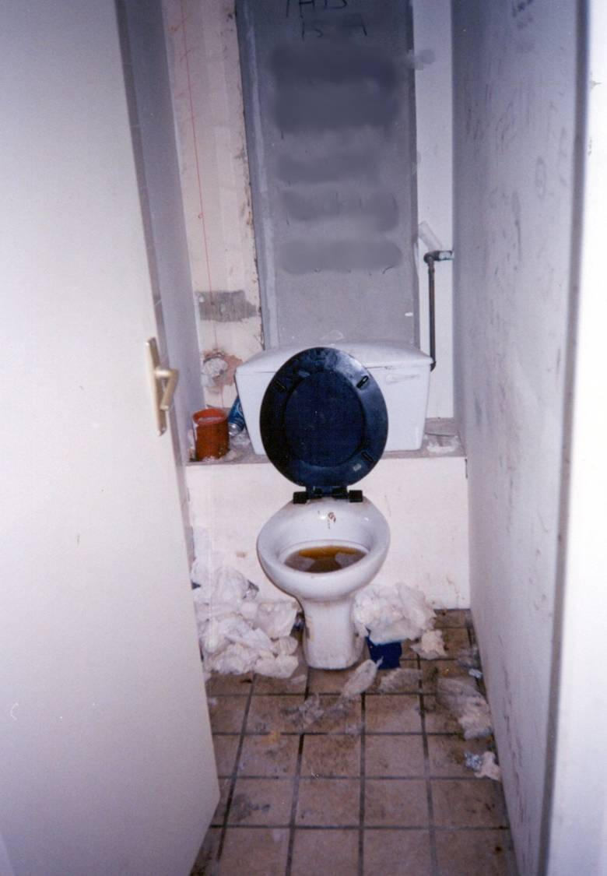
Is this an adequate and appropriate welfare facility?
Notes:
Not acceptable in many fronts - Discuss

Slide 8
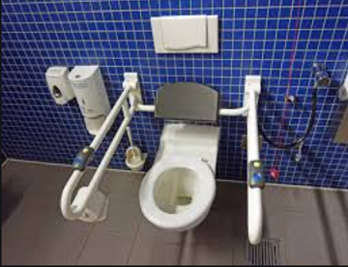
Is this an adequate welfare facility?
Notes:
It appears an acceptable facility. Other areas are not visible to observe.

Slide 9
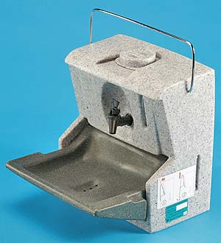
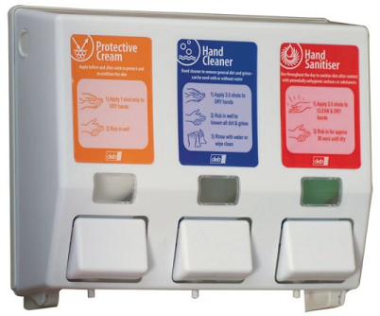
Is this an adequate portable handwashing facility?
Notes:
One with a handle is an acceptable portable hand washing station. The other associated facilities are not visible - lathering and drying agent. One has to watch for manual handling issues and the requirements of the manual handling regulations.
The other one is an acceptable system for vans, fire tenders etc. The paper for drying the dirt on hands are not seen.

Slide 10
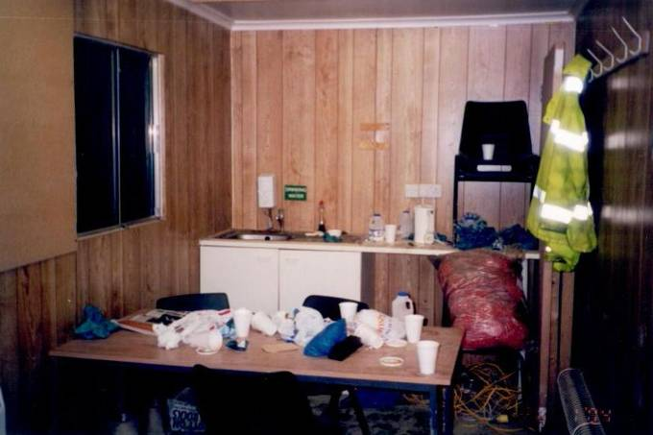
Is this an adequate and suitable welfare facility?
Notes:
Not right now.
It would become an acceptable facility, if it is cleaned and kept tidy by the employer and the users.

Slide 11
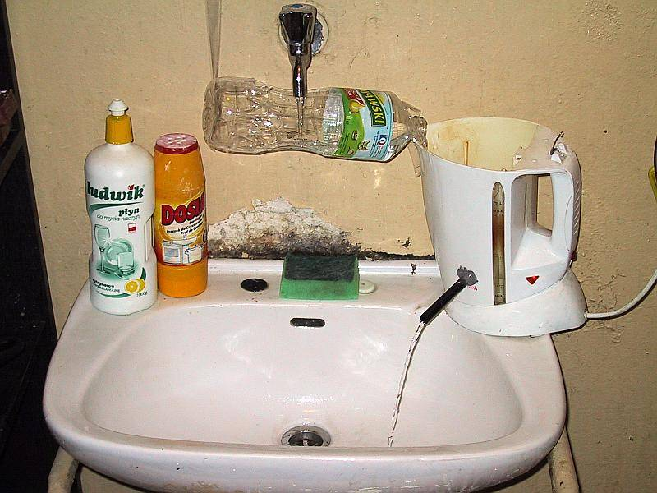
Is this an adequate welfare facility?
Notes:
An Imaginative DIY running hot water. The facility is not acceptable.

Slide 12
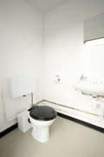
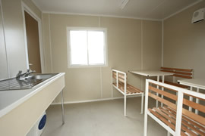
Is this an adequate welfare facility?
Notes:
Yes

Slide 13
Note to Lecturers
For SGUK certificate Word template please contact
contact@safetygroupsuk.org.uk

Slide 14
Notes:
No Notes for this slide

