Slide 1
Respiratory Protective Equipment (RPE)
Notes:
Summary
This practical based PowerPoint presentation (PPT) is aimed at creating a nudging environment to show (i) the importance of correct selection and use of RPE, (ii) why an inadequate face seal and facial hair in the faceseal region of a facemask will not provide adequate protection against dust.
What do I need to use this PPT presentation? (Optional activities)
Access to internet and YouTube. 1 x LOcHER respirator, 1 x 5ml disposable syringe, 1 x a length of micropore plaster, 1 x a length of decorators’ masking tape, 2 x medium sized balloons, 1 x faceseal demonstrator rubber tube, 1 x faceseal demonstrator rubber tube with Velcro wrap and a Bellow air pump (all included in the LOcHER demo kit available from BSIF).
How long will it take to present?
About 15 minutes, excluding optional activities. Optional activities are undertaken by your audience.

Slide 2
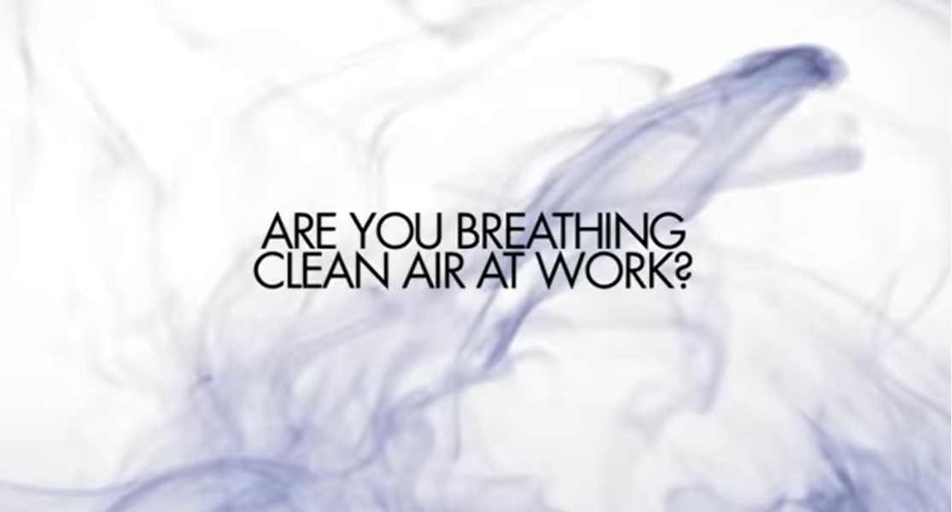
https://www.youtube.com/watch?v=uK4W8by44zo
Notes:
This presentation provides a concise summary on how to select, use and maintain RPE.
Play the film

Slide 3
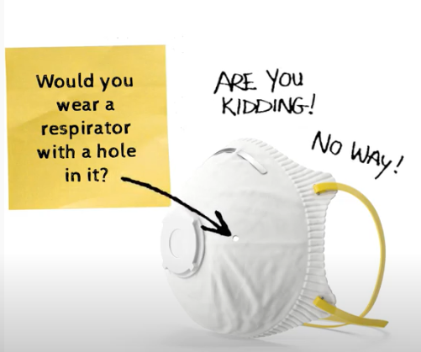
Correctly wearing Respirator
https://www.youtube.com/watch?v=SBzA3_8OOX8&feature=youtu.be
Notes:
This one minute film illustrates the importance of face seal between the respirator and the skin of the face. Hundreds of RPE wearers ignore this. The COVID-19 experience shows that, some wearers would not have achieved good faceseal and because of that they would have lost the protection afforded by the respirator.
Play the film

Slide 4
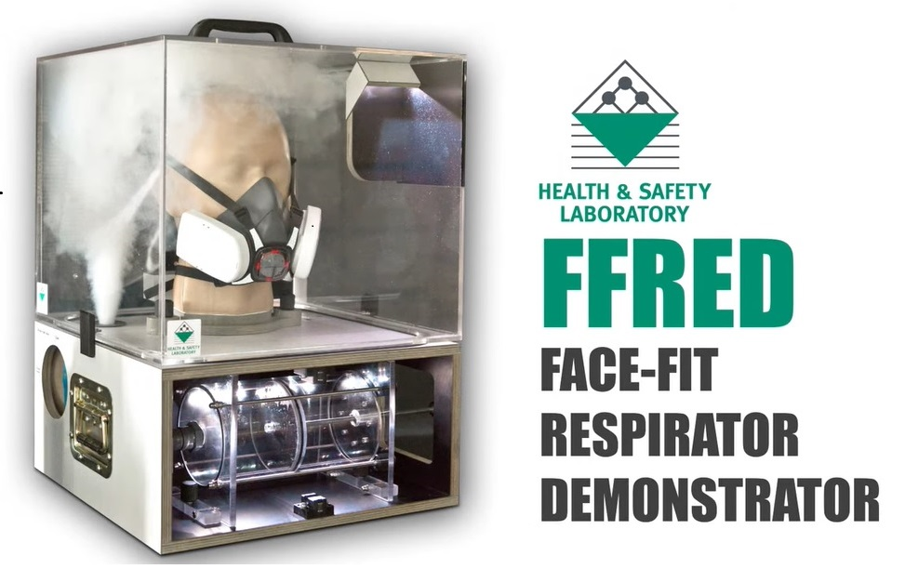
Effect of Poor Faceseal –Demonstration
https://www.youtube.com/watch?v=Eub0nWMF-vM
Notes:
Following research by HSE, they created this equipment, named FFRED. It is for demonstrating the effect of facial hair in the faceseal region. FFRED is a heavy and very expensive piece of kit to do the demo. You will see a simple LOcHER approach in a later slide.

Slide 5
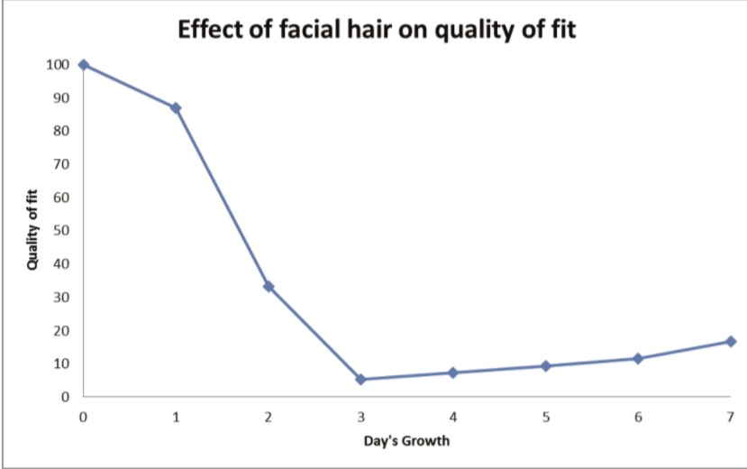
Source: HSE
Notes:
Now, let us look at the facial hair problem and its effect on real people.
At HSE, they used several male volunteers to study the effect of facial hair growth on the goodness of faceseal of respirator facemasks.
This graph shows that even a day old stubble can cause very significant leak through a respirator faceseal. It means significant loss in the protection.
For a moment, please reflect on this findings and the demonstrations seen in previous slides.
Would you be happy to have sulphuric acid fume or welding fume or asbestos dust in your lungs because the respirator is not the right one for the substance or the face mask is not the right size for your face or the correct respirator did not have a good faceseal?

Slide 6
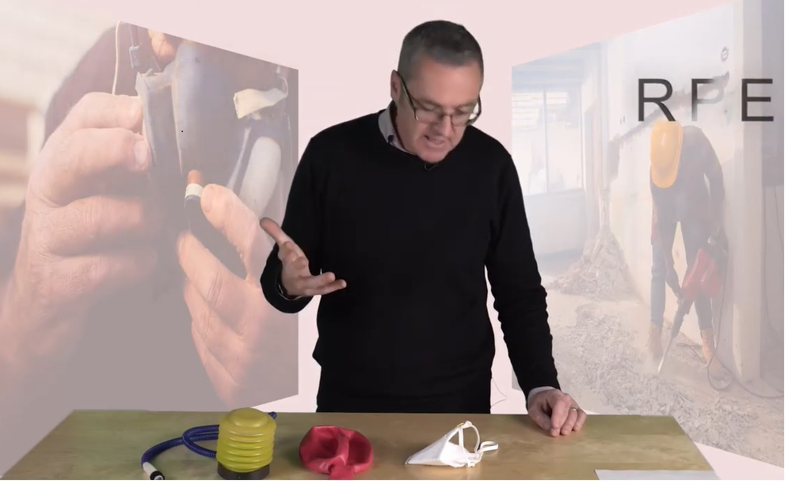
Effect of Facial Hair on Fit - Demonstration
https://www.youtube.com/watch?v=3jSnozhIFvQ&feature=youtu.be
Notes:
In this film, Professor Fishwick is using a LOcHER experiment to demonstrate the effect of facial hair on face seal.

Slide 7
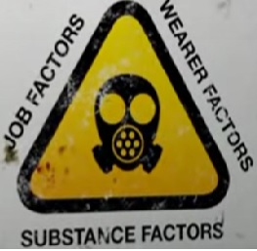
Key Factors Determining the Effectiveness of RPE
Source: Clean Air. Take Care!
Notes:
In summary,
Wearing suitable and correctly fitted respirators at work is one of the critical ways to protect workers from breathing toxic dust, fume and vapours in air.
In order to get adequate protection from a respirator, it must be suitable for the task, wearer, working environment and the substance (e.g. silica dust).
And respirators must be worn, stored and maintained correctly.
Failure to adhere to any of these can lead to exposure to dusts, fumes and vapours, leading to lung disease and the potential for early deaths.

Slide 8
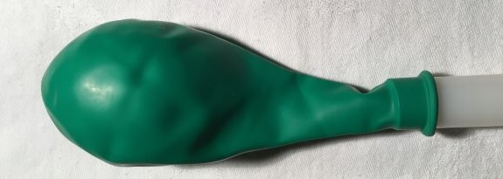
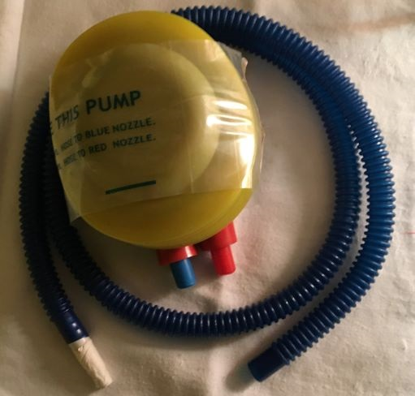
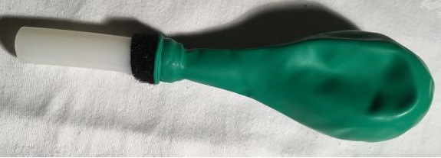
Effect of Poor Respirator Faceseal
Notes:
Optional Activity
LOcHER hands on
Having seen demonstrations in previous slides, your learners/trainees may wish to get ready a kit and use the kit to gain personal experience.

Slide 9
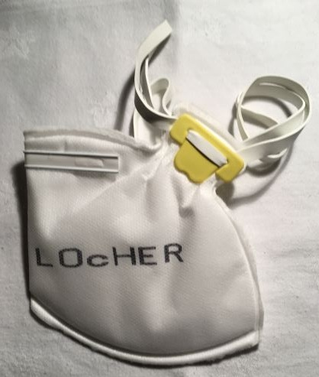
Effect of Poor Respirator Faceseal
Notes:
Always remember, for any tightfitting facemask like this one to work properly and protect the workers, it needs to achieve a good seal between the skin of the face and the respirator faceseal.
By the way, this LOcHER mask is for demonstration only.
RPE used at work must be certified by a competent authority like HSE or CE marked.

Slide 10
Unacceptable RPE Use Practice
Source: Clean Air. Take Care!
https://www.bsif.co.uk/wp-content/uploads/2015/02/Clean-Air-Take-Care-PowerPoint-presentation-2016.pdf
Notes:
These workers’ employers and these RPE users were taking risks with their precious lungs and health.
Never do these types of acts and expect the respirator to save your lungs.
Your employers can face enforcement actions by HSE.
For the Presenter: please allow adequate time for the audience to digest and discuss the information on the pictures.
Ask them, what they might do differently.

