Slide 1
How does Dust Exposure at Work Damage Our Lungs?
Notes:
This presentation will take about 15 minutes

Slide 2
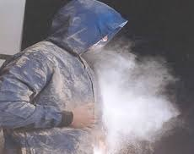
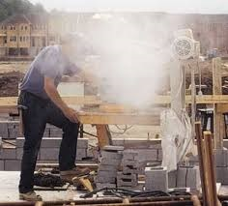
Dust at work- Many Situations
Notes:
1. The worker wearing the blue coverall is getting exposed to dust. He is wearing PPE alright.
Learning Activities:
(i) So, what action is creating the dust in his breathing zone? (trying to remove dust from his coverall by patting/tapping with hands)
(ii) Is the wearing of PPE protecting him? (Not really, it is making the potential for (a) dust exposure and (b) work related lung problems worse; this is an unwanted, avoidable exposure)
(iii) What other control measures should have been provided by his employer, in the first place, for the worker to control his dust exposure? (Dust control at source; must have been extracted using an extractor or could have used other methods that do not create dust in air, for example buying pre-fab components, where practical, a down-draught extracted bench if it is the right one for the job.)
2. The worker, cutting stone, is getting exposed to large amounts of dust.
(i) What hazardous substance is likely to be present in that dust? (silica or crystalline silica)
(ii) What could be done to minimise dust creation when cutting stone with a circular diamond tipped saw? (Using a portable industrial grade vacuum cleaner attached to the dust extraction point of the saw.)
(iii) Do you think, just wearing the street clothing is a clever idea? (No, dusty environment like this means, the worker could take home the dust. Family members, including young children, could become exposed. That’s not fair or right.)
3. Apart from dust exposure, what other types of exposures could have happened to the stone cutter? (E.g. noise, hand arm vibration, manual handling (back problems), as he would have to frequently bend down to pick up stone bricks and then to stack after cutting; Saw is not positioned at a height to suit the worker and to prevent bending when cutting; possibly dermatitis due to skin exposure to dust.)

Slide 3
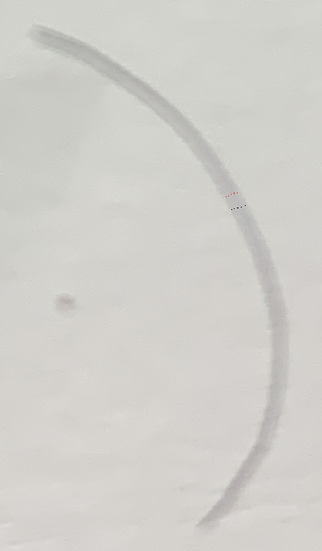
Dust Particles and Sizes
Expanded view of a hair strand
Tiny particles
A grain of sea sand, expanded view
Notes:
Dust particles generated at work are made up of different shapes and sizes, just like our clothing and shoes.
Our hair strand is about 70µm in diameter, which is about 15 times smaller than the tiny one millimetre space marked-up on a ruler(presenter please use a ruler to explain).
In this slide, a 70µm diameter hair strand is shown in expanded/enlarged view.
About 7 in number, 10µm dust particles will sit across, side-by-side within the hair strand and is shown by dots – black and red dots.
An oblong looking image on the side of the hair strand is a grain of sea sand- expanded view
Nearly 25 in number, 2.5µm dust particles will sit across, side-by-side, within the hair strand.
So, you can imagine how small are the dust particles that cause damage to our lungs.

Slide 4
Dust Particles Sizes (diameter)
> 10µm = 0.01mm | Coarse particles | Deposit in nose, throat and windpipe
< 2.5µm | Fine particles | Deposit in air sacs
< 0.1µm | Ultrafine particles | Can enter blood vessels from lungs
70µm | Human hair | For reflecting sizes
Notes:
In this slide a comparison with a hair strand is repeated for further illustration and explanation.

Slide 5
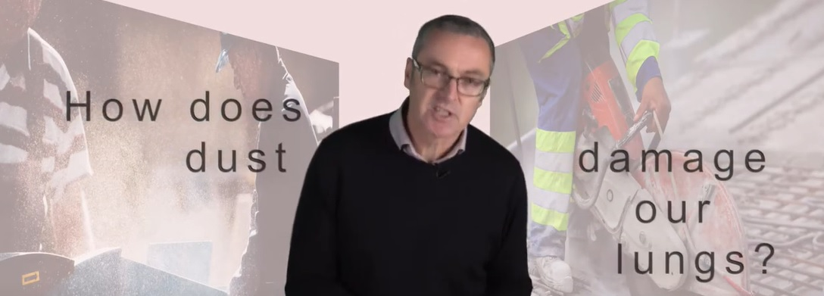
https://www.youtube.com/watch?v=PxD3pnTVyi4&feature=youtu.be
Notes:
In this short film, we can see Professor Fishwick carrying out a very simple and effective demonstration to show, “How does dust damage our lungs and other parts of the respiratory system?”

Slide 6
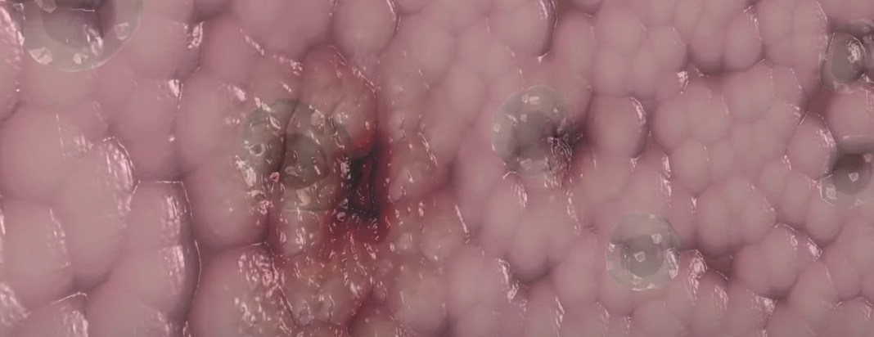
A virtual demonstration of Silica Dust Causing Damage to Our Lungs
https://www.youtube.com/watch?v=vCcON72KcMA&app
Notes:
This virtual film produced by the Work Safe of the Government of British Columbia (in Canada) shows very well, the effects of exposure to silica dust.

Slide 7
https://www.youtube.com/watch?v=ih8zaJBBL60
Notes:
In this 2 minute film, Professor Fishwick tells us what happened to a wood worker who was exposed to wood dust.
LOcHER hands on
On the Table used in the film, did you note a hazardous substance used in your trade.
(presenter, please run the film again and pause when the Table appears and ask the question)
(ii) Pick a substance or two and ask what kind of occupational diseases (asthma) could be caused if workers are exposed to them (this question help to reinforce asthma in their minds)

Slide 8
https://www.youtube.com/watch?v=WLHtcfYWRb4
Notes:
In this sobering story, Professor Fishwick will tell us what happened to an engineering worker when he was exposed to metal working fluid mist at work.
Play the film
So, having listened to real and virtual examples, there is never an excuse to get the job done while putting your health at risk.
Does anyone disagree with me?

Slide 9
How can dust Damage our lungs?
Examples of Lung problems
Persistent coughing
Wheezing
Extreme tiredness (body and lungs)
COPD
Asthma
Cancer
Notes:
As a summary, I list few examples of lung problems that can be caused by breathing dusty, misty and/or fumy air at work.
Having viewed simplified demonstrations and explanations, I am sure you will appreciate why many types of lung conditions develop over time and about thousands of workers die early each year. It’s not fair or reasonable to die because an employer did not provide adequate exposure controls to dust and created the problem for you or you failed to use the control measures correctly.
Always remember, employers have legal duties to put in place suitable control measures to protect your health and wellbeing.
You should correctly use the exposure control measures provided.
You should be trained and supervised to do the job safely and without putting you or others health at peril.
Employers should test and maintain control measures to ensure they are working properly.
Here is my most important and sincere message, always remember, your lungs are precious and every breath counts.
Learning Activities
How many of you would be prepared to have your overalls covered in dust?
How many of you consider that working in dusty environment is part and parcel of a job?
What are the key legal duties I mentioned in this slide. (They should tell you about the duties of employers to provide control measures, training, instruction, supervision, testing and maintenance of work equipment and that of employees.)

