Slide 1
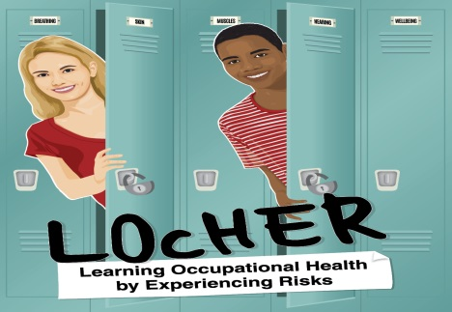
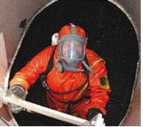
Confined Spaces - they can be Deadly
Notes:
This presentation will take about 15 minutes

Slide 2
Work in Confined Spaces It can be Deadly
Notes:
In this country, about fifteen people are killed and many others are seriously injured each year in confined spaces. These tragedies have happened:
when workers making an entry into or working in confined spaces and/or
When someone is trying to rescue workers who are in danger in a confined space.
The ultimate life or death danger in confined spaces is lack of precious oxygen to sustain life.
Therefore, the Confined Spaces Regulations lay down stringent requirements for undertaking work in confined spaces. Those entering or working in a confined space must receive extensive information, practical training, instruction and supervision to work in confined spaces.
Workers need to be assessed as competent and suitably healthy to work in confined spaces.
This presentation is not about making you a competent person to work in confined spaces. It will give you an introduction to emphasise the dangers involved in confined spaces, so that none of you will become a statistics, even when trying to help others in danger.

Slide 3
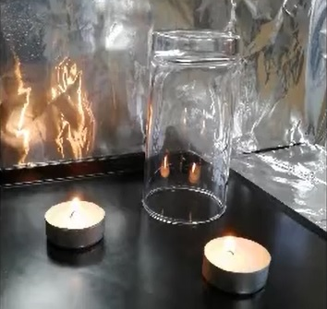
Effects of Oxygen Deficiency
https://youtu.be/a4iJitZGWUA
Notes:
This one minute demonstration will show very effectively what could happen to life when a space lacks oxygen. Here we are using a candle to represent a person.
I am sure, it will stay in your memory and should act as a reminder about the dangers of confined spaces.
LOcHER hands on: you can do this demonstration (using the items similar to those used in the film.) You must seek permission from the college.
Learning Activity
So, What do you think is a confined space? (Ask learners to come up with examples. – e.g. sewers, wells, pits, tunnels)
After discussion:
(The next slide will give the definition described in the Confined Spaces Regulations and give a number of examples)

Slide 4
What is a confined Space?
Any place, including any chamber, culvert, tank, vat, silo, pit, trench, sewer, flue, well or similar space in which virtue of its enclosed nature, there arises a reasonably foreseeable SPECIFIED RISK
Notes:
By the way, some employers and workers think that working in partially open enclosed spaces like the culvert shown in this slide cannot ever present immediate danger to life.
That is not always true. Many workers have died because of this myth. Even a partially open culvert, room or a compartment can quickly become subject to a SPECIFIED RISK. (this is explained in the next slide).
A culvert like the above can become an oxygen deficient death trap when people do painting, shot blasting and undertaking other activities that create lots of dust, fume and gases. For example, cleaning up a wet sewage without a safe system of work. Remember the rotten-egg smelling gas.
For the Presenter: (practical demonstration - Demonstrating how a partial enclosure can become an oxygen deficient atmosphere. After lighting the tealight, partially cover it, leaving a bit of opening with outside. To the amassment of your audience, the candle will go out after awhile.

Slide 5
Specified Risks
Defined in the regulations
Loss of consciousness arising from exposure to gas, fume, vapour or the lack of oxygen
2. Loss of consciousness arising from an increase in body temperature
3. Serious injury from fire or explosion
4. Drowning as a result of engulfment by liquids or solids
Notes:
The Confined Spaces Regulations define Specified Risks that will fall under the powers of the regulations.
The conditions that fall under specified risks are listed on this slide.
Learning Activities
(i) Can you give an example of a work activity, where the body temperature can rise quickly without suitable precautions. (e.g. welding inside a tank which has been exposed to intense sun like in a desert or a hot summer day.)
(ii) Give me an example where someone can be drowned by solids. (e.g. A person working in an empty grain silo with out a safe system of work. Another worker, not knowing of the work going on inside the silo, decides to load the silo with grain. (sugar or wheat, etc). The worker inside can become drowned , suffocated and die.
More examples of oxygen deficiency: For example, a pub cellar can become a confined space due to leaking carbon dioxide cylinder(s). The gas can build up quickly replacing the oxygen in the cellar air.
A closed room like a ship compartment or a caravan can become an oxygen deficient atmosphere when welding is undertaken. The welding fume can quickly cause oxygen starvation in the compartment. If gas shielded welding is undertaken, problem will be made worse by the shield gas like Argon

Slide 6
Requirements for Working in a Confined Spaces
Must comply with the Confined Spaces Regulations
Required measures must be put in place to establish and maintain a safe system of work
No work must take place until the safe system of work is operational
Notes:
Work in confined spaces must comply with the Confined Spaces Regulations.
These regulations set out the measures to be established for setting up and putting in place a safe system of work by a competent person who has knowledge, skill and experience on work and controls in confined spaces.
Never attempt to prepare a safe system of work in a confined space, UNLESS you are a Competent and Authorised Person.

Slide 7
Work in Confined Spaces (CS) and Danger to Life
Comply with the Confined Spaces Regulations
“safe systems of work” must be in place, including
Making sure access to breathing quality air
You are competent to do work in CS
Notes:
I am going to repeat the message once more, because your life is precious.
In order to look after your life as well as of others, your employer and you must always comply with the requirements of the Confined spaces Regulations, which include
Putting in place a safe system of work.
Making sure there will always be access to breathable quality air.
In most cases, it would mean using a suitable breathing apparatus.
You must be competent and medically fit and healthy to do work in an arduous and dangerous environment.
This presentation is only key introductory reminder of the extreme dangers associated with work in a confined space and what should happen to do work safely.

Slide 8
Work in Confined Spaces Can be Deadly
Notes:
Here is a poster summarising the main dangers that can arise when working in confined spaces.
Learning activity
you may invite your audience to create posters to show their understanding of safe working in confined spaces.

