Slide 1
Control of Substances Hazardous to Health
Basics
Dr. Bob Rajan OBE JP PhD
Vicechair, SGUK
Please study each slide with its accompanying notes to get to know the subject
Notes:
In this presentation, you are going to look at the essential requirements of the “Control of Substances Hazardous to Health Regulations.”
This law places duties on employers to ensure that employees can work safely with hazardous substances.
In addition, the law also places duties on employees, to correctly use the control measures provided. This is a must to minimise your exposure to hazardous substances at work and protect your health and of others around you.
Do you know Why? Because, all of us need to take appropriate measures to reduce the number of workers dying early or developing diseases every year, from exposure to hazardous substances at work.

Slide 2
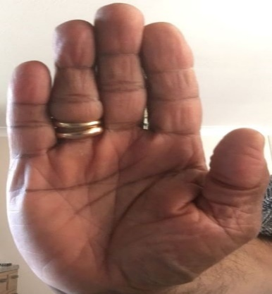
What is it about?
Employers must
Prevent
or
Employees
Exposure
to
Substances Hazardous to Health
Notes:
The fundamental principles of the COSHH regulations, are very similar to any other law – know the hazard, be risk aware, risk assess, put in place control measures, use control measures and maintain control measures. Review regularly to see things are working properly.
Employers should take actions to prevent or adequately control your exposure to hazardous substances.
In most cases, it is practical for employers to put in place adequate control measures at the point where the hazardous substance is being generated - so that you do not have to rely on Personal Protective Equipment (PPE) like gloves, coveralls and masks.
Learning Activity: Can an employer take control actions to stop a worker using a broom to sweep-up wood dust on floor? (Yes, if other practical measures can be used. For example, most of the time, the sweeping up job can be done using a high filtration efficiency vacuum cleaner to control dust exposure. Even better, if the dust creating activity could be prevented by buying pre cut, pre moulded components.

Slide 3
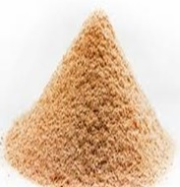
Hazardous Substances
Broad Categories
Manufactured chemicals and products
Natural and process generated substances
Microbiological agents
Waste materials
Notes:
The term Substances hazardous to health are defined in COSHH regulations.
Here is a simple way to introduce it to you – using the term
“Hazardous substances” can be placed in five broad categories.
Manufactured Chemical substances and products. For example, paints, brush cleaners, decreasing solvents, WD40, floor cleaners etc.
Natural substances like henna, rubber latex milk and proteins and citrus oils.
Substances generated during work activities such as:
stone cutting producing stone dust and deposited dust on surfaces;
wood sawing producing wood dust;
flour loading (into a mixer) producing flour dust;
diesel engine exhaust fume generated by a vehicle, or a machine;
welding fume.
Microbes or germs like bacteria found in unmaintained metal working fluid sumps in engineering workplaces; Covid19 virus released when patients/ill people are coughing in hospitals and in work places.
Wastes are one of the critical sources. For example, stone dust, cement dust, and used paint, glues and solvent waste individually or as a mix.

Slide 4
Hazardous Substances
Which one of these ? | Yes/No
Paints sold at DIY shops
WD40
Orange oils used in food factories
Flour dust in air in bakeries
Silica dust at construction sites
Industrial floor cleaners
Wood dust created at a saw mill
Welding fume in air in a car repair garage
Diesel fume in an engine shed or a construction site
Dry cleaning solvents
Notes:
All listed substances, including process generated (e.g. flour, silica and wood dusts, Diesel fume and welding fume), and products listed are substances hazardous to health.
Orange is not a substance hazardous to health. But citrus, and orange oils when extracted from these types of fruits or used at work are hazardous substances because they can cause irritation to the skin. Some people can become allergic to these oils.

Slide 5
Substances Hazardous to Health -
Hazard Symbols
Manufactured chemicals and products
Health Hazard (harmful) Exclamation mark
Corrosive (burns) Corrosion mark
Health Hazard (toxic) Skull and Crossbones
Serious Health Hazard (very toxic) A person’s top half with six arms star embedded
Microbiological agents
Notes:
Manufactured hazardous chemicals and products used at work should be supplied with safety data sheets, labels and hazard signs on them.
Learning Activity: (learning outcome – How to identify hazards in the workplace)
(Learners may be asked to
Identify hazard signs) What hazard signs are on product labels associated with products they use in their work area?
(if a product contains one or more health/safety hazards, it should carry relevant hazard signs)

Slide 6
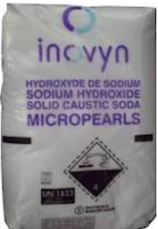
Hazardous Substances
What forms can they be present at work
Solids
Notes:
Hazardous substances found at work may be present in different forms. In this slide, we see:
Mortar mix in wet form – it can contact workers skin and cause irritation and burns; when dry, it can become powdery and float in the air to cause inhalation exposure.
Caustic Soda crystals in a bag – when made into solution and sprayed, they can be in aerosol form in the air. It could lead to inhalation exposure.
The manufacturer of the caustic soda has taken preventive action by making the powdery material into micro pellets. So, for example, when transferring into a mixing bucket or vat, these pellets will significantly reduce airborne dust, (so long as the bag is stored and transferred with care to prevent crushing of the bag and its content.)
Learning activity: You see a diamond symbol on the packaging. What is it telling you. If you do not know, go back to the previous slide .

Slide 7
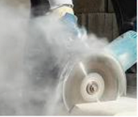
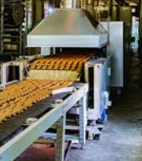
Hazardous Substances
What forms can they be present at work
Dusts (fine solids)
Silica dust
Wood dust
Flour dust
Notes:
In this slide,
we are seeing silica dust being created during stone cutting task.
A wood turner becoming exposed to fine wood dust, and
Flour dust settled on surfaces including floor areas.
Learning activity: Do you think silica dust is controlled at the point of cutting to prevent it entering the air around the worker. Discuss: what could be done to control the dust exposure at a motorway construction site, when doing a job like this. Just create ideas, they don’t have to be the correct control measure for this discussion.

Slide 8
Hazardous Substances
What forms can they be present at work
Solids Dusts
Fibres Fumes
Liquids Vapours
Mists Gases
Notes:
So, hazardous substances found at work may be present in different forms as shown on this slide.
Learning activity (learning outcome – How to identify hazards in the workplace)
(Learners may be asked to:) Explore the forms in which hazardous substances are found in their work area.
(Do not forget work activity generated substances – e.g. welding fume, solvent vapours; sprays released during painting; dust generated during sanding wood etc.)

Slide 9
Exposure Routes
Nose
Breathing
Eyes
Contact
Splashing
Landing
Mouth
Swallowing
Skin
Contact
Splashing
Landing
Notes:
Risks to your health from exposure to a hazardous substance, is associated with five main factors.
The hazardous properties of the substance: For example wood dust is a respiratory and skin irritant and a sensitiser. Some types of wood dust can act as a carcinogen.
How does the exposure take place: is it through eyes, skin, ingestion or breathing in. Breathing in hazardous substances, in air, is the major route of exposure. That is why many hundress of workers suffer from lung related problems.
The level of exposure: e.g. how much dust. It means concentration.
Duration of exposure: how long and how frequently (often).
For example, workers may be exposed to bleach spray at a very high concentration for few minutes and suffer severe respiratory problems; on other times, they may be exposed to low concentrations (dilute) every day for about three hours and may suffer lung problems after some times –days, months, years. (it is like a car tyre being getting worn over a period, lung tissues get damaged over a period caused by the exposure)
Health risks associated with hazard: exposure to wood dust can cause irritation of the respiratory system – the consequences include irritant cough, breathing difficulties, asthma and lung cancer.

Slide 10
Effects of exposure
At the point of entry or other parts of the body
Diseases include:
Lung cancer
Asthma
Liver diseases
Kidney diseases
Dermatitis
Burns
Notes:
According to HSE, nearly 50 bus loads of workers are dying early every year due to lung disease caused by inhalation exposure to substances hazardous to health. One bus load = 60 people.
Nearly 150 bus loads are dying due to work related cancer caused by hazardous substances.
So, please. Take care. Work safe. Go home healthy.
Use control measures provided; Don’t take short cuts.

Slide 11
What should an Employer DO?
Notes:
What should your employer do to protect your health when using hazardous substances?
It is summarised here as six key essential steps. We will look at these steps in detail on the next slide.
Risks assessment
Put in place preventive or control measures
Prepare and support employees
Ensure correct use and maintenance of controls
Carry out any workplace surveys as needed
Prepare for emergencies
Learning Activity (learning outcome – How to deal with a simple emergency in a workplace)
Consider exploring an example emergency measure for an incident involving eyes. (e.g. eye wash station: the wash bottle is located at a point easily accessed, bottle is in-date, not damaged and dirty, workers have been trained on how to use; signs to direct workers in an emergency)

Slide 12
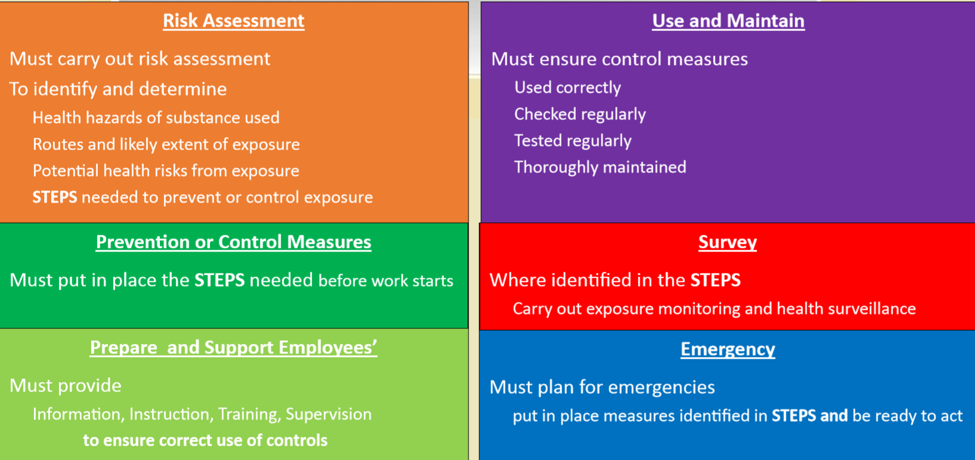
What should an Employer DO?
Notes:
Self explanatory descriptors. You may select an activity in your work area where a hazardous substance is used, download the relevant HSE’s COSHH ESSENTIALS DIRECT ADVICE SHEET and use it to create a risk assessment. For example, wood dust and hand-held tool for sanding, you will use WD 7 - https://www.hse.gov.uk/pubns/guidance/wd7.pdf
The risk assessment you create could be used as part of your course work submission. Make your life easy, use the HSE template:
Risk assessment: Template and examples - HSE

Slide 13
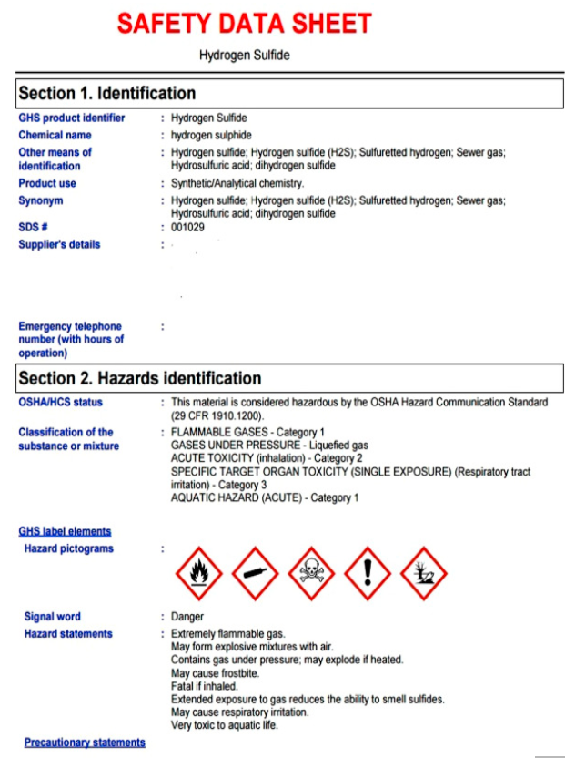
COSHH Risk Assessment – Myth 1
A green man is a risk assessment to cross the road
NO
A SDS (or a file full of SDSs) is a COSHH risk assessment to do the job
Notes:
A green man is only an indication that you MAY cross the road. You still have to look right, look left, look right again before stepping onto that “dangerous” road. There may be a rule breaking trucker, absent minded Alicia in your way, bicyclist Bryan looking at the advert, Martha with a pram, rushing for an appointment and right in your way, and to make it worse, my dog William is standing in your way.
So, it is simple, the green man is ONLY one of the sources in your risk assessment and one of the steps in your risk control measures (crossing the road safely) and preventing the consequences (not falling down, getting injured or even killed.)
In the same way, a Safety Data Sheet is one of the information sources for getting to know about the hazardous substance. Your employer will use it (see previous slide) to determine task or process or an activity specific risk assessment which include all the steps needed for risk control (see slides 10 and 11) . These are needed to protect your and other employees health and safety.
Hey, it is simple as Avoid, Protect, Control.
Got it

Slide 14
COSHH Risk Assessment – Myths 2 & 3
2. It is a natural substance. It cannot hurt.
Not true - for example, exposure to henna, flour, wood, and silica dusts can cause ill health.
3. We have used this substance for a long time and in the way we are using it, today. So, it must be safe.
Not true - some harmful effects of exposure can take decades before taking hold and showing up – e.g. lung cancer
Notes:
As explained on the slide

Slide 15
COSHH Risk Assessment – Myth 4
4. What do you expect; it’s a dirty job.
Not true - why does it has to be a dirty job. Lots of ways a job can be made safe and clean. An important part of a work is good house keeping
Think about your vocational study and how hazardous substances are used and the way work is done.
Notes:
As explained on the slide

Slide 16
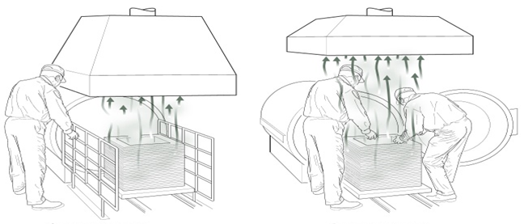
COSHH Risk Assessment – Myth 5
Control Measures Look Okay!
Control measures should be competently designed
One of these is not
Notes:
Learning Activity (learning outcome – How to control the exposure to a hazard)
On the left hand side illustration correct control actions are put in place what are they?
(Barriers to prevent the operator working in the fume zone. (i) A larger, and significantly enclosing hood (the area of fume release) when compared to the other hood on the slide and (ii) placed much closer to the source releasing the fume. Fume is extrcated and the operator’s breathing zone is not in the path of the fume, compare with the other situation shown on the slide.) Often, DIY extraction ventilation is a mess up job.
Learning Activity (learning outcome – How to control the exposure to a hazard substance) What is wrong with the design on the right hand side (as you face the slide)? (self evident, and read the descriptors above). You could use this in your risk assessment and any others found at a workplace.) Get a better grade.

Slide 17
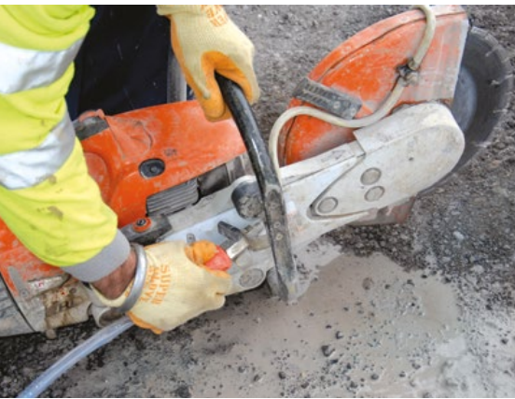
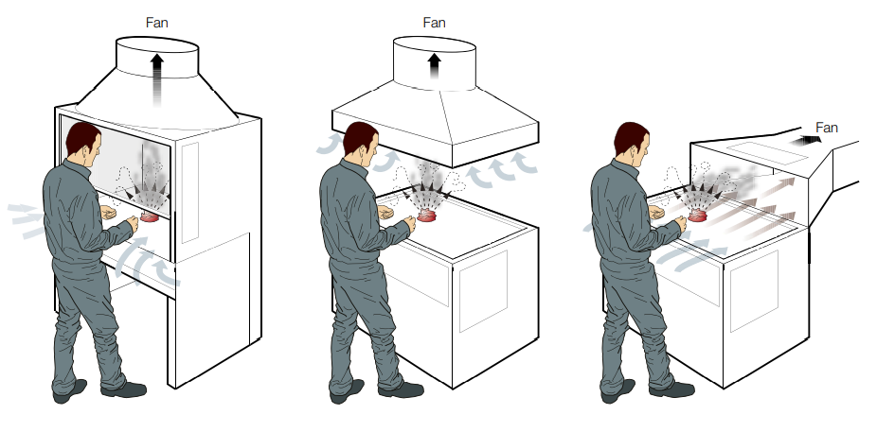
Common Control Measures
Wetting
Extraction
Respirators,
Gloves, and
Coverall
Notes:
The examples on this slide are not replacement for suitable risk assessment and controls.
In construction industry, during stone cutting, silica dust in air could be supressed by wetting the point where the saw does the cutting.
In bakeries, flour dust is supressed in different ways, depending on the size of the bakery and the products made. You will see examples in other COSHH related presentations.
Extraction - of suitable design, construction, use and maintenance, - is one of the common methods to extract hazardous substances in air.

Slide 18
A Useful Hazard/Control Check List
Does the product you use have a danger label? (slide no. 5)
Does your task/process produce dust, spray, fume, gas, and/or vapour?
Is the substance/product you are using is harmful to breathe in? - read Safety Data Sheet (SDS)
Is the substance/product harmful to skin? (look SDS)
Are you coming into contact with it because of the way you are using?
What control measures are in place?
Notes:
You can check you answers against Employer risk assessment. If you are not satisfied speak to your employer or your safety representative. This table is to help you. It will NOT take away the responsibilities of your employer.
This is a simple checklist for your use only and not a replacement for adequate and suitable risk assessment which should be undertaken by your employer.

Slide 19
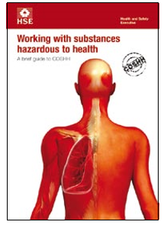
Reading Material
INDG136
Working with substances hazardous to health: A brief guide to COSHH (hse.gov.uk)
Notes:
Down loadable for reading on screen

Slide 20
Questions
Please print out slide 21 with clock time showing.
For the questions on the slide, select either
TRUE or FALSE answer and mark
Please remember, if you are not sure of the answer go back to the marked-up reference slide, read more and then come back to answer the question.
Please provide your answer sheet to your tutor.
You are likely to get a certificate for completing this module. You may place it in your progression assessment/employment folder.
Notes:
No Notes for this slide

Slide 21
COSHH
Brooms are designed for sweeping, so an employer can put them to use for wood dust cleaning without being justified in a COSHH risk assessment (slide 2)
COSHH Regulations require that employees exposure to substances hazardous to health should ONLY be adequately controlled. (slide 2)
Worker exposure to wood dust are not subject to COSHH. (slide 3)
Silica dust exposure at work does not come under COSHH because it is a natural substance found in any beach. (slide 3)
A product with Skull and Cross bones sign, on the label, means it is a substance hazardous to health. (slide 5)
Splashing of hazardous substances could lead to skin exposure. (slide 7)
In most workplaces, main route of personal exposure to a hazardous substance is through skin. (slide 9)
Suitable control measures must be put in place before working with hazardous substances which can cause exposure. (slide 11 and 12)
True
False
True
False
True
False
True
False
True
False
True
False
True
False
True
False
Notes:
No Notes for this slide

Slide 22
Note to Lecturers
For SGUK certificate Word template, please contact
contact@safetygroupsuk.org.uk
Notes:
OPTIONAL Assignment Activities (learning outcomes – How to identify hazards, control measures and put them in place before work starts)
(i) (team work or individual assignment):
Explain the key features of the COSHH regulations and apply them in selected areas of their work activities (for safe working with a hazardous substance.)
(they will explain the six essentials steps and the facts associated with them and apply them in their selected work activity example. To help them, they can draw information in INDG 136 (see next slide) and the relevant HSE’s COSHH ESSENTIAL DIRECT ADVICE SHEETS to prepare an all round and an excellent assignment and provide a list of references, safety labels on containers and safety data sheets relevant to the substance being looked at.)
Describe the methods used for identifying the hazardous properties of a manufactured product containing hazardous substances (for example concentrated metal working fluid.)
(product labels, safety data sheets, Hazards warning signs and HSE’s COSHH ESEENTIALS DIRECT ADVICE SHEETS.)
If a worker has suffered work-related asthma due to exposure to a hazardous substance at work, is this reportable to the Health and Safety Executive (HSE) under the RIDDOR regulations? If yes, who should report this and how will it be reported?
(Yes, employer or their appointed person; online to a central point using a prescribed on-line form. More information can be seen in HSE website - https://www.hse.gov.uk/riddor/report.htm)

Slide 23
Notes:
No Notes for this slide

